Slide 1

Downloading the fee statement
Go to www.lsue.edu
Click on myLSUE

Slide 2
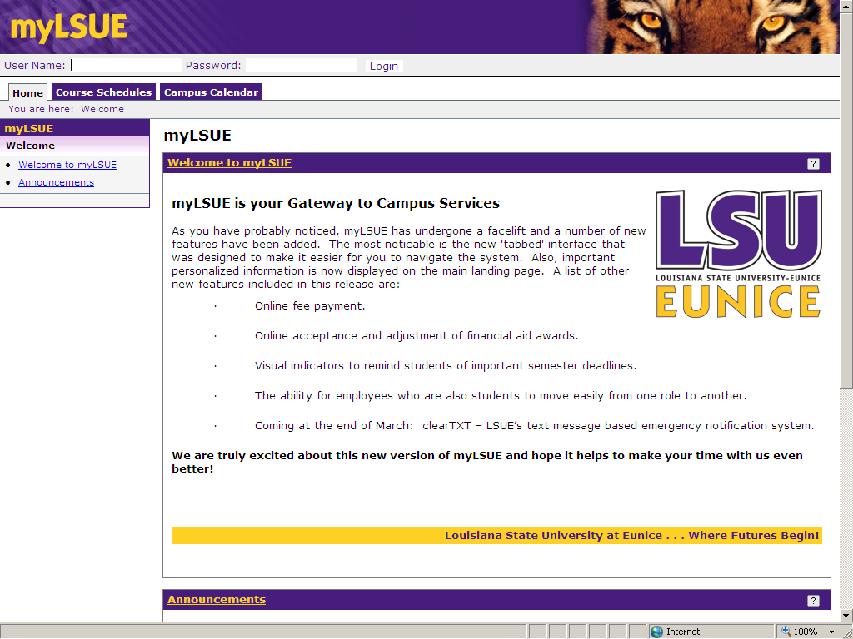
Click login
Enter Student ID and PIN

Slide 3
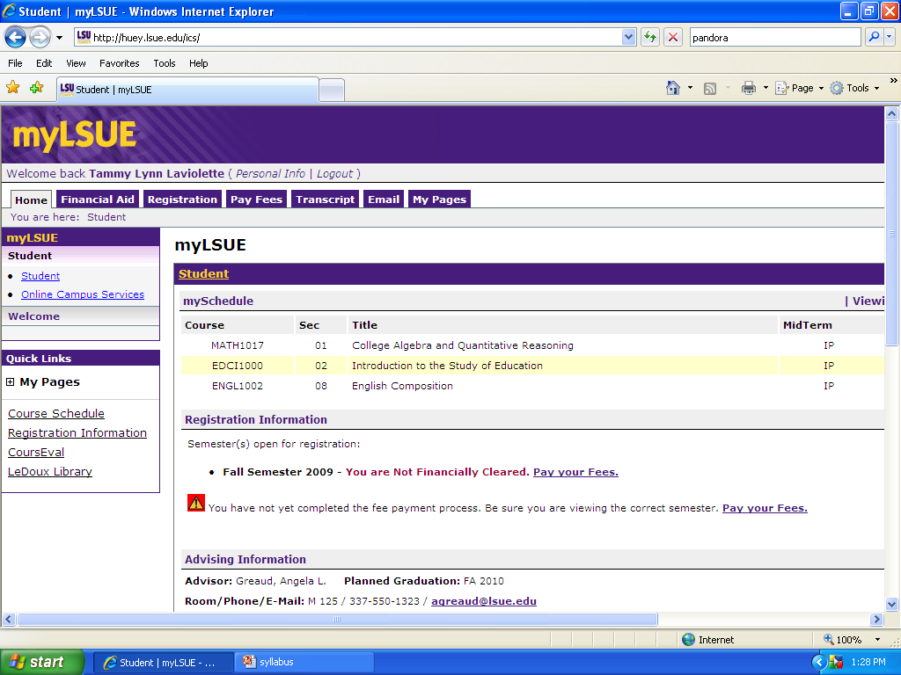
Your Name
Click “pay fees”
Notice all of the other functions
Semester info
Your courses are
listed here, if not
be sure your semester
in the upper right is set
correctly.

Slide 4
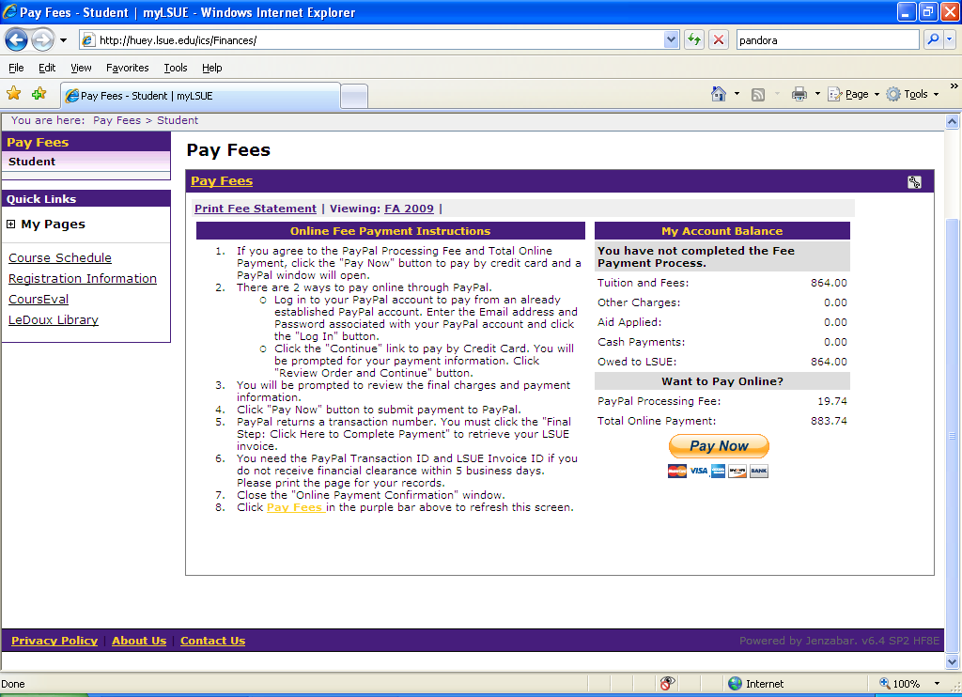
Click “print fee statement to see classes and rooms.
Semester info must be set correctly.

Slide 5
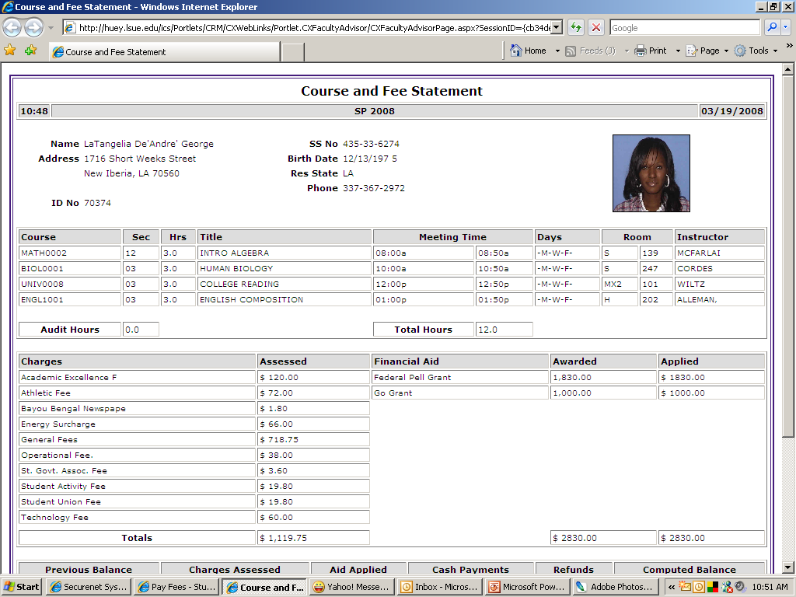
Your name
Address
City, state, zip
ID number Should appear here
Make sure all information is correct.
Classes below
Financial aid information
is in this area.
Please print this page.

