Slide 1
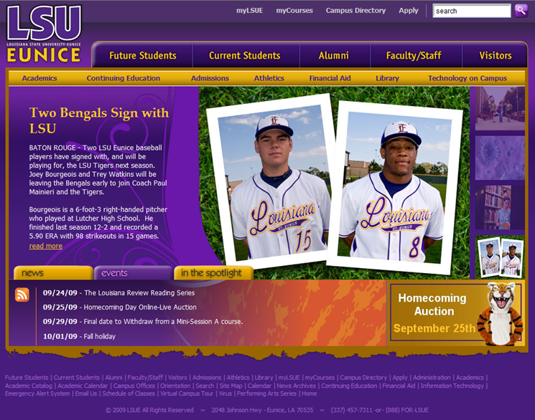
Opening myCOURSES and printing a syllabus. Go to www.lsue.edu
Click on myCOURSES

Slide 2
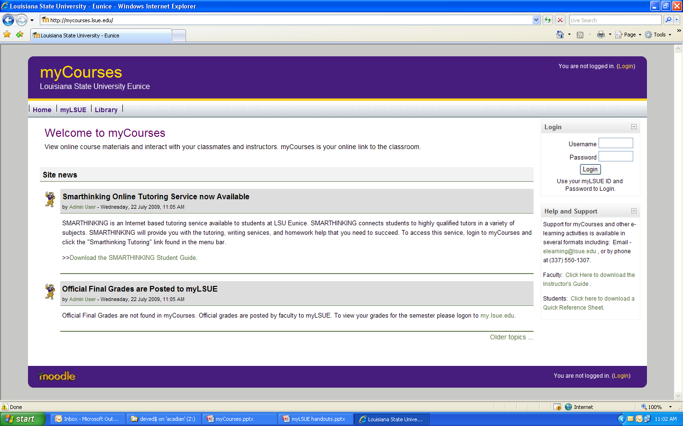
Enter Student ID and PIN, then
click “login”
Notice the tutoring service that is available 24/7.

Slide 3
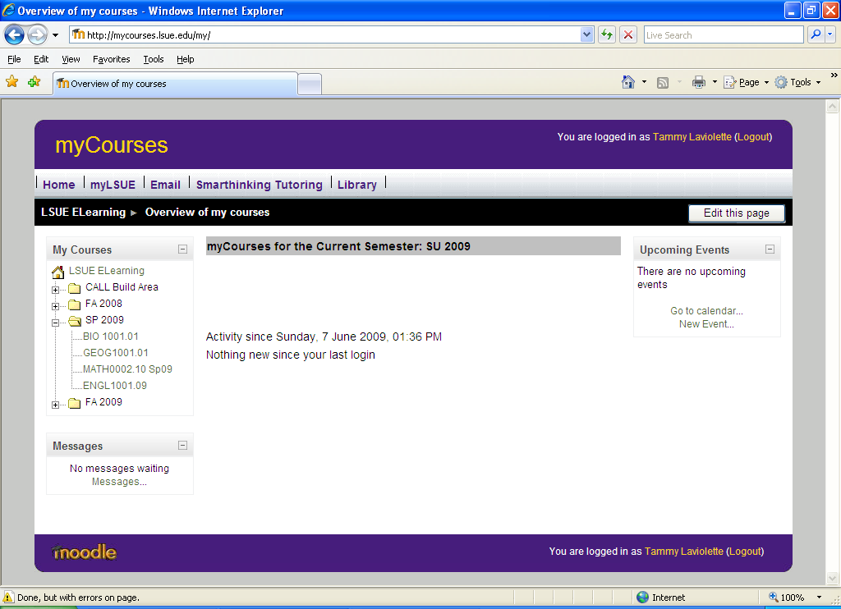
Notice that you can also access e-mail, myLSUE,
and SMARTHINKING tutoring.
Student
Click the appropriate semester, then
click the appropriate course.
All courses should show regardless
whether the faculty member is using
myCOURSES or not.
Student

Slide 4
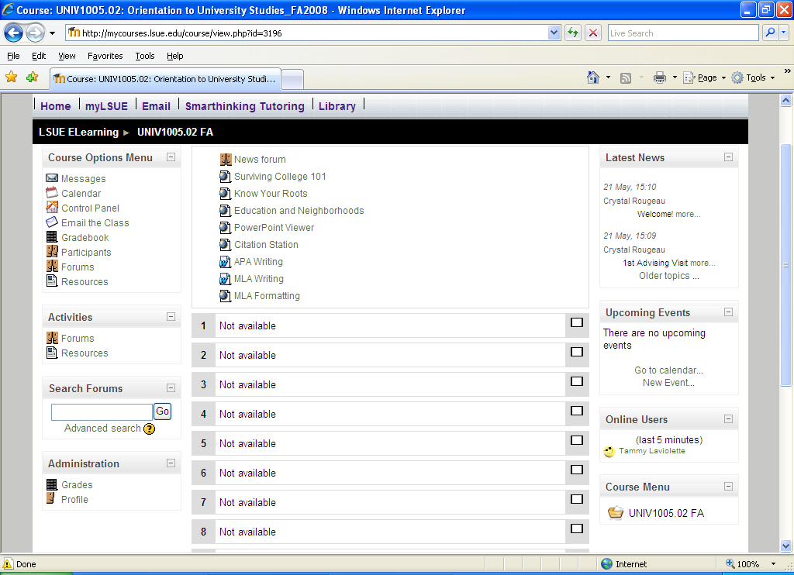
From here, each faculty member’s myCOURSES is different.
Please ask your faculty member
where the course syllabus is so you may download and print it.
Your course syllabi may be printed at home or in any campus lab with a current ID.

