Slide 1


Advisor Training Spring 2023

Slide 2
Student Success Center Advising
The Student Success Center (SSC) will now be responsible for advising LSUE campus students with under 24 hours of college-level credits.
The organizational restructure is "moving the needle!"
Description | Fall 21 | Fall 22
Success Rate A, B, C, P only | 7378/10636 = 69.4% | 7876/10707 = 73.6%
Number of students with a GPA < 2.00 | 837/3039 = 27.5% | 727/3088 = 23.5%
Number of Pathways Students with a GPA < 2.00 | 169/837 = 20.2% | 106/727 = 14.6%
Number of new first-time students with a GPA < 2.00 | 312/837 = 37.3% | 278/727 = 38.2%

Slide 3
Pre-Advising Appointments
The SSC has implemented pre-advising appointments for entering first-year students on the main campus. (scheduled via Navigate)
Advisors send communication to prepare students for visit or virtual meeting, letting them know what is needed to have a successful meeting.
Review advisee in advance to see if student needs to be informed of academic bankruptcy, account holds, etc…

Slide 4
Pre-Advising Appointment
During this appointment, students are encouraged to submit ACT scores, transcripts, and to take the Accuplacer exam (if applicable) BEFORE reaching back out to register for classes. Students are provided with a recommended degree plan based on their test scores.
Share follow-up information with advisees as it becomes available. May include dates for advising and scheduling (set-up appointment via Navigate), new course/program information, upcoming opportunities for internships, scholarships, etc…

Slide 5
Advising Visit and Scheduling
Discuss class options for degree, preferred dates and times, section availability, progress, etc…
Suggest complete semester schedule of classes. Enter information from discussion in advising notes space in myLSUE then clear student.
First-time students should be completely scheduled by the end of the advising visit. Continuing students may just need coaching on scheduling their own classes.
Make sure student has been informed of fee statement, aid application, deadline for being financially cleared, and ramifications for failing to do so.
What additional services does the student need? Housing, ODS, food insecurity, connectivity issues, testing facilities, counseling, Veteran's Affairs benefits, etc...

Slide 6
Advising Visit and Scheduling
Helpful questions you can ask:
  Do you have scheduling constraints? We recommend a 5-day week for a full-time student, just like any full-time 40 hour a week job.
    Encourage the student to speak to their employer. Most of them do not and just assume their employers will not work around their school schedule. They won’t know if they don’t ask!
  Do you have children? Are you a caregiver for someone?
  Do you have reliable transportation to campus? Are you carpooling with other students? If so, what are their schedules like?
Discuss availability:
  MTWRF is ideal for success. Not all courses are available on specific days.

Slide 7
Communication Requirements
Have clearly understandable communication expectations established and available to advisees.
Return student email or phone calls within 48 hours of business week. It is preferred that it is no more than 24 hours. Even if it is just to confirm receipt of their email or message.
Any time that advisors are off campus and unavailable, “out of office” messages must be activated on phone and email account. These should be approved at the divisional level for consistency.
Regular communication with advisees about upcoming dates and events.
Maintain office hours for advising.
Process paperwork from advisees in a timely manner.

Slide 8
General Degree and Certificate Requirements
Students must meet the curricular requirements for a degree as outlined in one issue of the LSUE Catalog.
Students must achieve an overall grade-point average (GPA) of 2.0 (C average) or better on all college work attempted, plus a minimum grade-point average of 2.0 on all work taken at LSUE.
Students must earn 25 percent of the credits required for the associate degree at LSUE. All students must be enrolled at LSUE during the semester in which degree requirements are fulfilled.
Students must take a minimum of 15 semester hours within the academic division granting the associate degree.
Students shall receive no degree credit for developmental courses.
See LSUE's catalog for further details

Slide 9
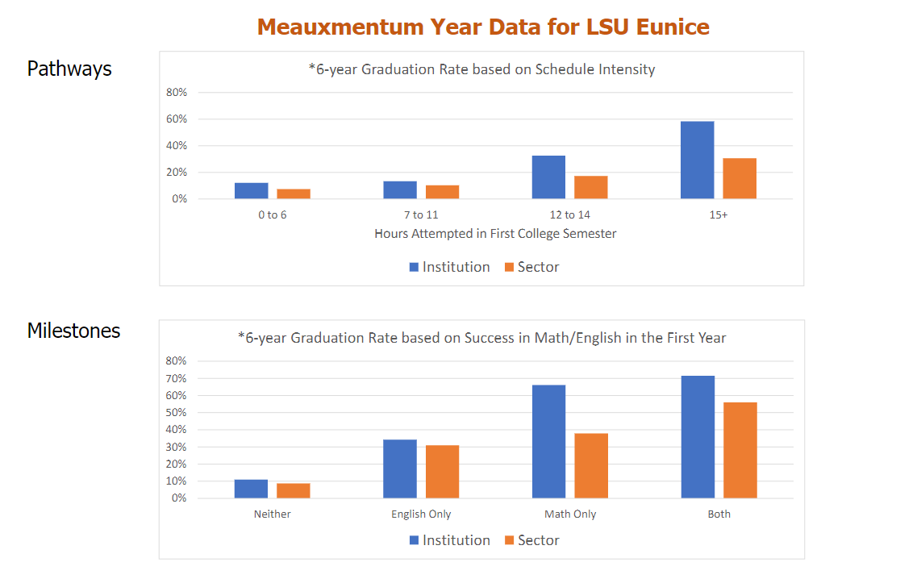
Save Time and Money

Slide 10
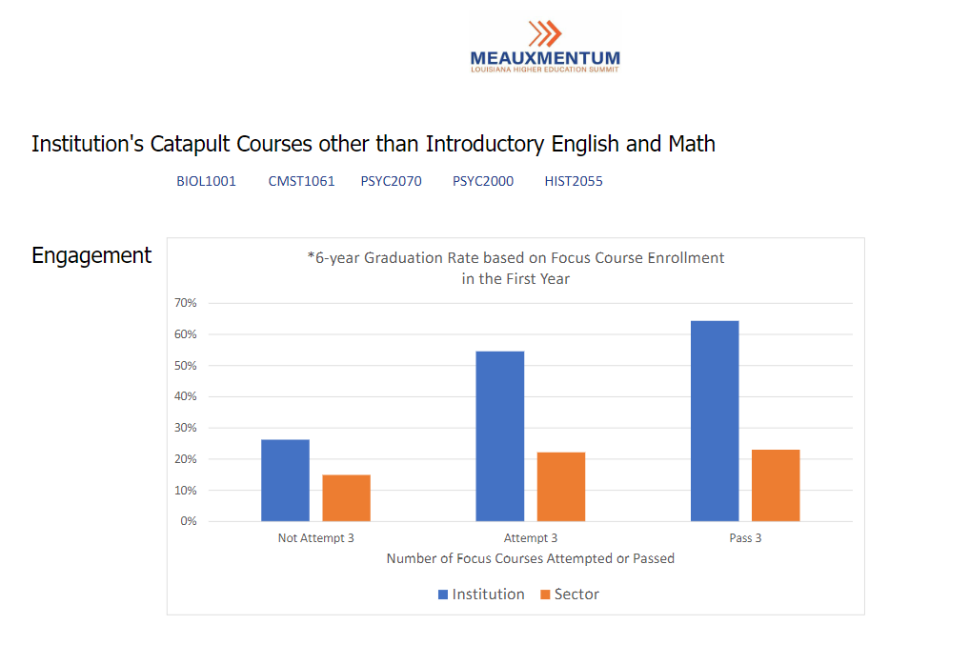
Save Time and Money

Slide 11
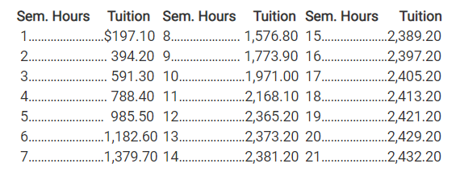
Save Time and Money

Slide 12
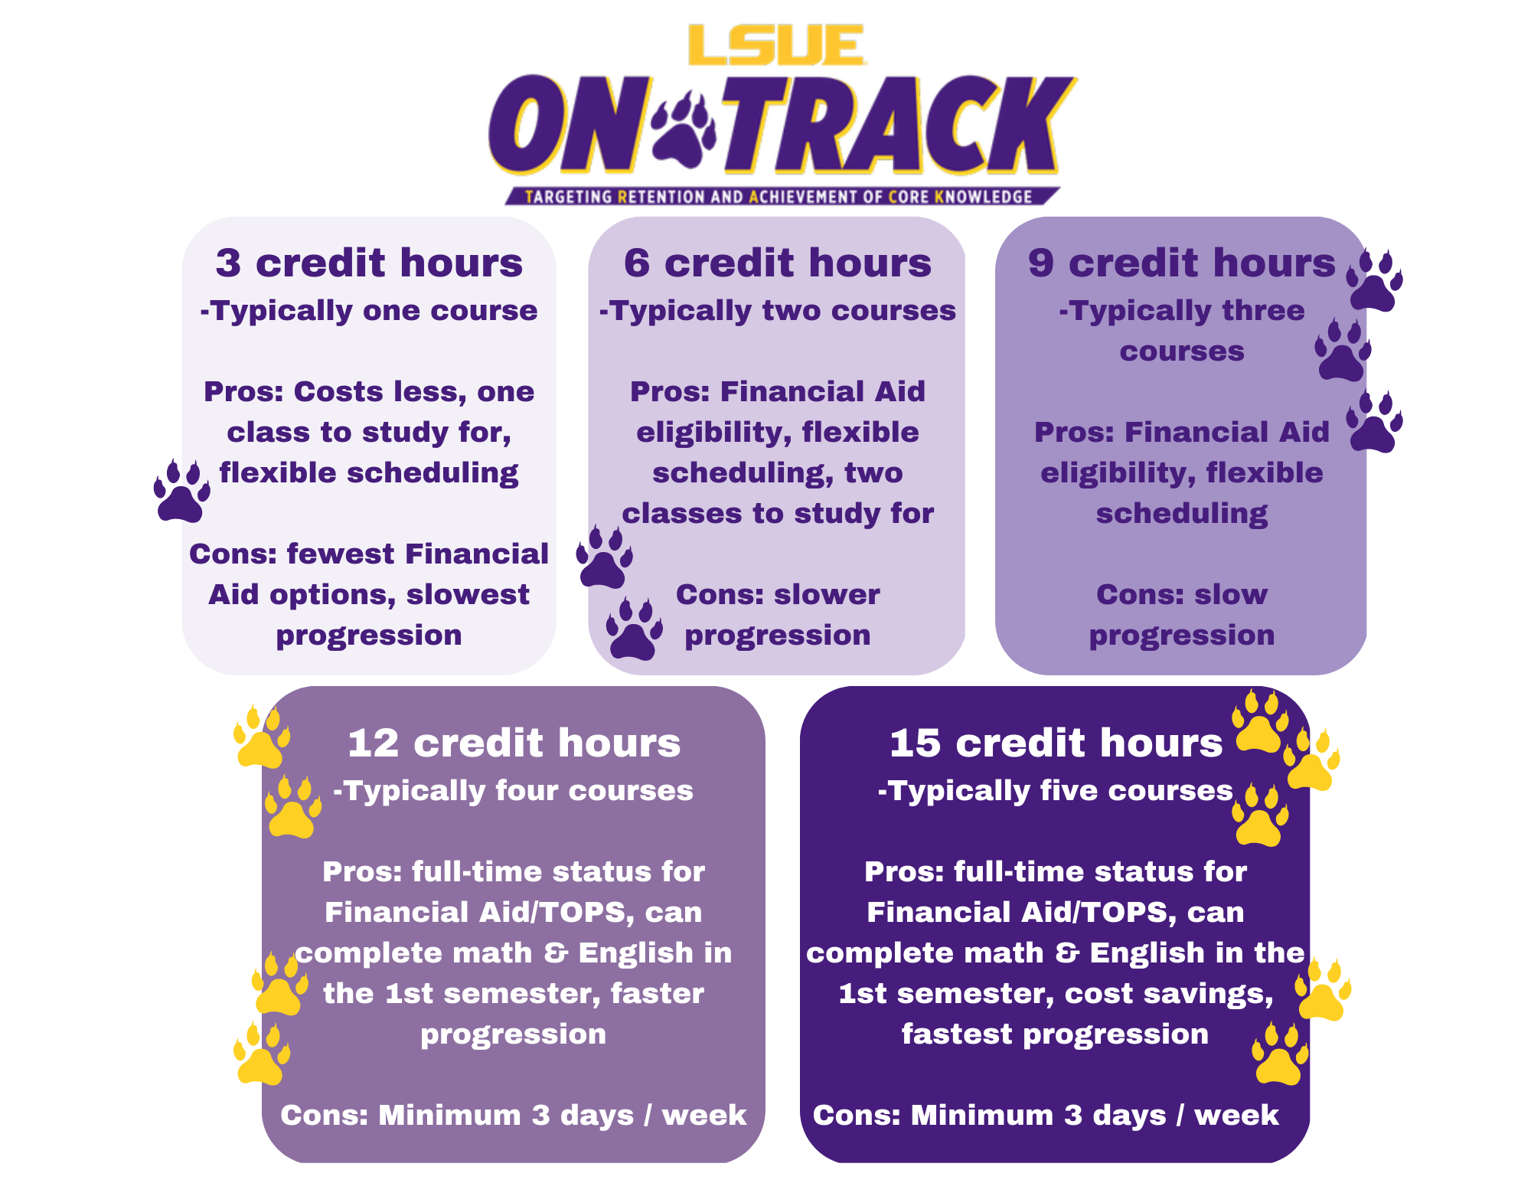

Slide 13
Scheduling Co-requisites
Each designated gateway English and math college level section will have an identified co-requisite section.
The co-requisite course will be added first then the English or math course.
Because there are no restrictions in place to stop non-pathways students from swapping sections, advisors must emphasize that each college level course is paired with a particular co-requisite course.

Slide 14
Co-Req Examples
Co-requisite sections that are linked:
MATH0022T TA College Algebra Supplement 3 Miller, C -M-W-F- 9:00- 9:50AM M204
MATH1021T TA College Algebra 3 Jean, J -M-W-F- 8:00- 8:50AM S144
Pathways Cohorts Only:
ENGL0101T T2 English Composition Supplement 2Jones, R -M-W-F- 9:00- 9:50AMC110
ENGL1001T T2 English Composition 3 Jones, R -M-W-F- 8:00- 8:50AM C110

Slide 15
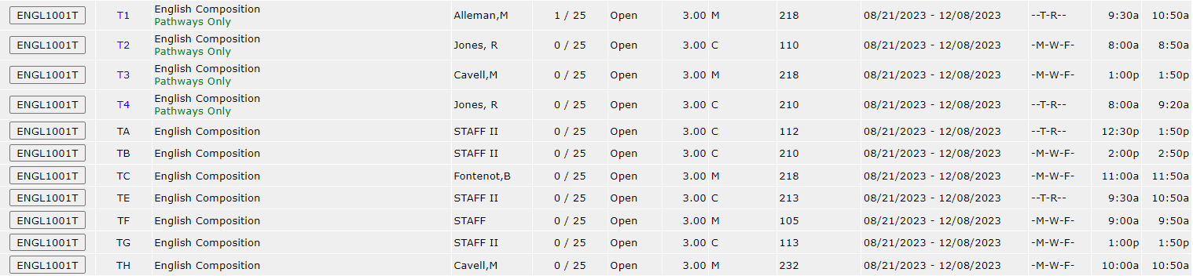
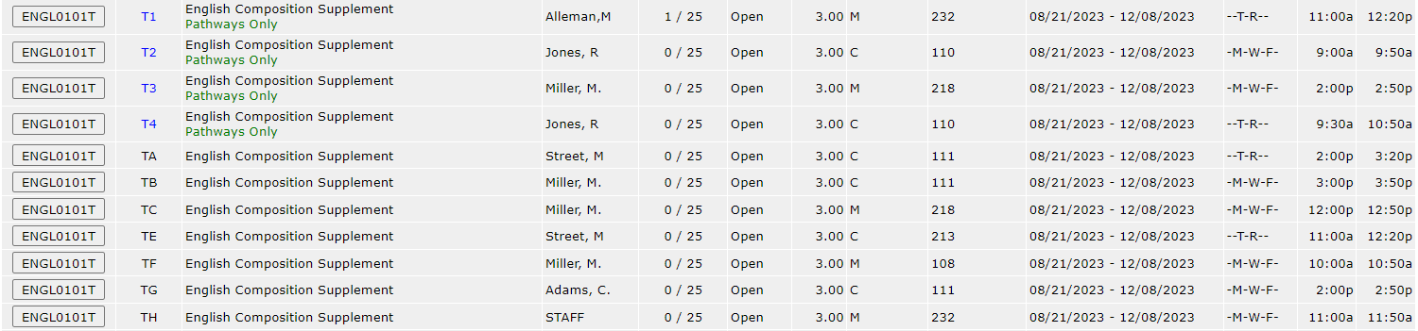
Co-Req Examples

Slide 16
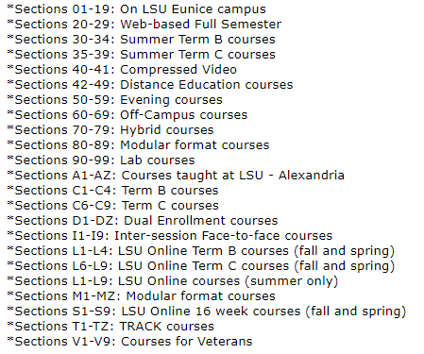
Section Guide

Slide 17
Updates to Course Prerequisites
Courses are still being updated with C&C documentation
Typical re-write:
Old: Eligibility to schedule college-level English and Mathematics.
New: Credit for or eligibility to schedule college-level English and Mathematics without co-requisite course.

Slide 18
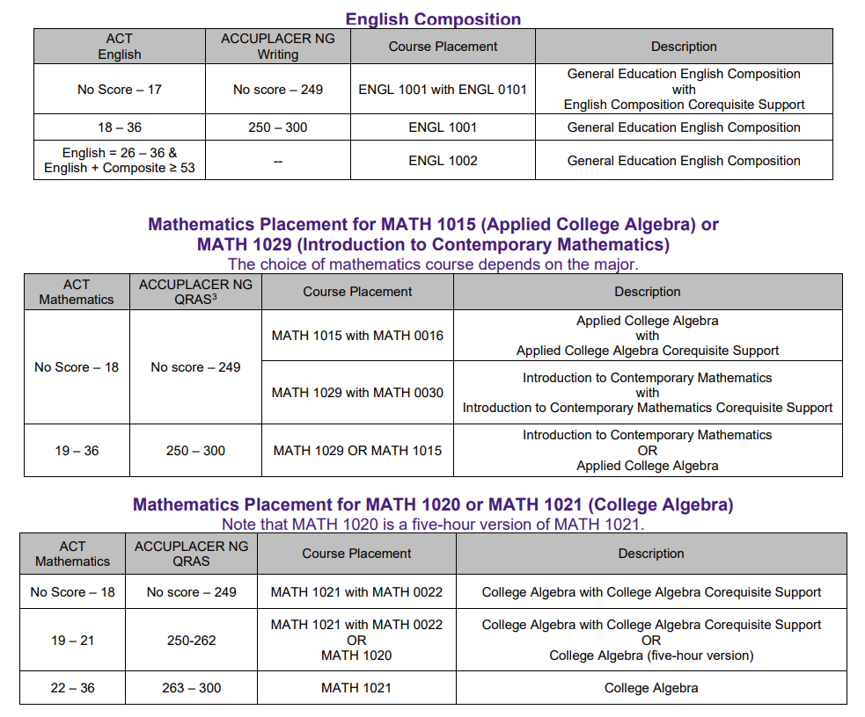
Cut Scores
Cut Scores

Slide 19
ACT Residual
Residual tests are intended only for students planning to attend LSU Eunice. They are not for TOPS qualification purposes.
The ACT Residual is typically offered in May before the start of the summer semester and again in August before the start of the fall semester. Contact Chad Jones for more information.
Alternative to taking BIOL1001 for students (specifically nursing & allied health majors) who are just missing the 21 in Science on the ACT. Scoring a 21 can make a dramatic time difference in degree completion for students in these majors.

Slide 20
Navigate
Navigate is a student success management tool for faculty, staff, and students.
In addition to issuing student performance and attendance alerts, Navigate can be used as an appointment scheduler.
By syncing your Outlook calendar and setting your availability in Navigate, students can schedule advising appointments during the times that work for you. This feature is a great way to keep your office hours, classes, and appointments organized.
Faculty who are interested in utilizing Navigate for scheduling advising appointments should sign-up to receive an invite for small group training sessions.

Slide 21
Pathways to Success Updates for Faculty and Advisors

Slide 22
What is Pathways to Success?
LSUE is an open admissions university
P2S is for students that either:
    Have an ACT score composite of 15 or below OR
    Have no test scores
Pathways to Success exists to provide structure to this targeted student population by (a.) mandating specific courses/advising, (b.) mandating attendance, and (c.) mandating tutoring

Slide 23
P2S: Mandating Advising/Courses
Go over the Pathways to Success Contract with each student and have them sign it
  Return signed contracts to the Student Success Center
Pathways students are only allowed to take specific courses
Pathways students cannot make schedule changes on their own; a Pathways advisor is required for changes
Pathways students must meet with an advisor twice each semester as part of their UNIV coursework

Slide 24
P2S: Mandating Advising/Courses
Pathways to Success advising is similar to advising for non-Pathways except it has restrictions on the courses that can be taken. A typical P2S student will take the following courses during the first semester:
First Semester
UNIV1005 ENGL0101 + ENGL1001 MATH0016 + MATH 1015 OR MATH0022+ MATH1021 OR MATH0030 + MATH1029

Slide 25
P2S: Mandating Advising/Courses
Other P2S restrictions include:
P2S students cannot take more than 15 credit hours
    Exception: Athletes can take 15 hours + their HPRE courses
    Exception: LSU Pathways students can have one extra elective
P2S students cannot take online classes
P2S students must have a break after every two classes in a row.
This typically means no T-R only classes if student requests to be full-time

Slide 26
P2S: Atypical Scenarios
While most P2S students will follow the courses in the previous table, students sometimes place into other courses based on their ACT or Accuplacer scores. In these scenarios, their scores will take precedence.
Scoring above a 16 composite on the ACT or an average of 250 on the Accuplacer before beginning school will allow a student to be taken out of Pathways.
Once a student has completed some of their P2S courses, they can be scheduled into other courses based on their major.
Notes:
Regarding the last point:
This rarely occurs. However, on occasion you may come across a student who just cannot complete a P2S required course, such as MATH0015, but has completed all other P2S coursework and P2S electives within their major. While students in this situation can take more advanced coursework in line with their curriculum, all other P2S restrictions do still apply.

Slide 27
P2S: Block Scheduling for Fall 2023
There are 4 cohorts designated for Pathways to Success Students. These sections are listed with a T and a #. For example, ENGL0101T section T2.
  Students in these cohorts should take all the courses/sections within the designated track.
Non-P2S students will not be allowed to register for these sections.

Slide 28
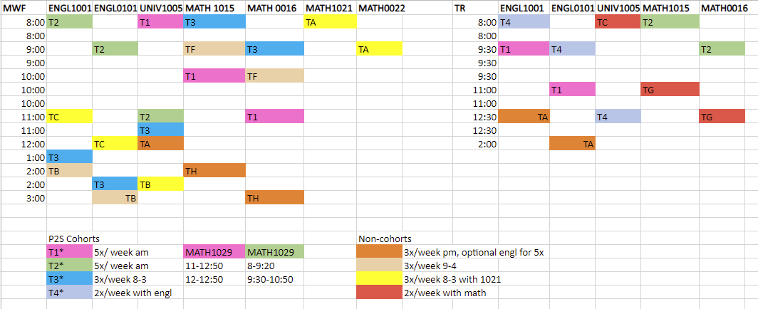
P2S: Scheduling – Fall 2023

Slide 29
P2S: Mandating Attendance
Class attendance is required for Pathways to Success students, regardless of whether a professor requires attendance.
Not attending can result in automatic failure of a course
Attendance rules allow students to miss, at most:
  two (2) classes for a summer course that meets three, four, or five times a week,
  three (3) classes in a regular semester for a course that meets three times a week,
  two (2) classes in a regular semester for a course that meets two times a week, or
  one (1) class in a regular semester for a class that meets once a week.
Note: Attendance information is submitted by professors directly to the Pathways Coordinator. As an advisor, there are no actions you will need to take regarding attendance.

Slide 30
P2S: Mandating Tutoring
Students who receive a grade below 70% or a C- on a major assignment in either English or math are required to participate in tutoring for two (2) hours per week until their grades reach 70% or higher.
All Pathways students are encouraged to attend tutoring.
Note: Tutoring information is submitted by professors directly to the Pathways and Tutoring Coordinators. As an advisor, there are no actions you will need to take.

Slide 31
P2S: Exiting Pathways
Students that have completed all required Pathways courses are marked as Pathways Complete by the Pathways Coordinator once grades are posted each semester.
Students can exit P2S before starting any coursework by either testing out of all support courses with the Accuplacer OR by submitting an ACT score with a composite of 16 or higher.
    Once a student has started Pathways coursework, they are in P2S.
Students wishing to take online-only classes can exploit a loophole to exit the P2S program by swapping to our online-only (CALL) campus.
    https://www.lsue.edu/studentaffairs/pathways-to-online.php

